Slide 1
Category review: Chips
September, 2023
Retail Analytics

Slide 2
Notes:
To view Privacy video explaining how important data privacy is to Quantium, please click here: https://www.youtube.com/watch?v=Zq1QDAkoRzU
or here Q:\Company Reference\Brand & Design\Brand videos\Q Privacy.mp4
At Quantium, we believe that data is the behavioural footprint of humanity and that it has to be treated with the utmost care and responsibility.
Histories, attitudes, indeed lives are stored within it in ways that aren’t always apparent – and that’s what makes its potential so powerful.
To work with it responsibly, sensitively, we set ourselves the highest data privacy protection and governance standards.
We have spent 17 years perfecting privacy-by-design and secure-by-design principles. Central to this is not holding any personally identifiable information about people –
we neither receive it, and put the necessary protections in place to be unable to decipher it.
Every aspect of handling data is safeguarded: from its de-identification, to its encryption – data security is paramount and of the highest grade.
We pride ourselves on gaining the trust of iconic organisations around the world through years of securely working with their data,
and in turn the trust that builds with their stakeholders.

Slide 3
Executive summary
01
Chips Category Review
There is an increase in sales before Christmas and zero sales on Christmas day, this can serves as an advantage within the region.
Most frequent chip pack size purchased is 175g followed by 150g pack size for all segments.
The Mainstream category of Young and Mid-age Singles/Couples have the highest spending of chips per
purchase.
Young and Mid-age Singles/Couples is the only segment having Doritos as the highest purchase brand while Smiths is for other segments.
Mainstream young singles/couples are 27% more likely to purchase Twisties.270g pack of chips compared to the rest of the population.
Chips Brand Kettle is the most purchased brand in all stores.
02
Store Analysis
Trial stores 77 and 86 have significant increase in total sales and number of customers during trial as compared to control store.
Trial store 88 had increase as well but not as good as stores 77 and 86.

Slide 4
01
Category

Slide 5
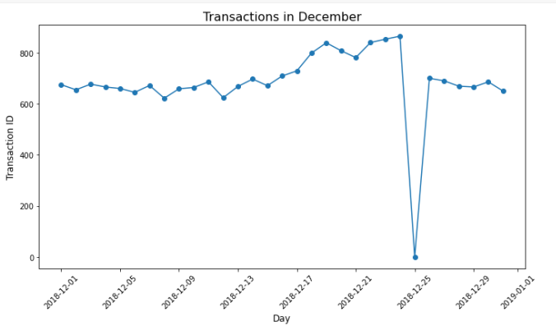
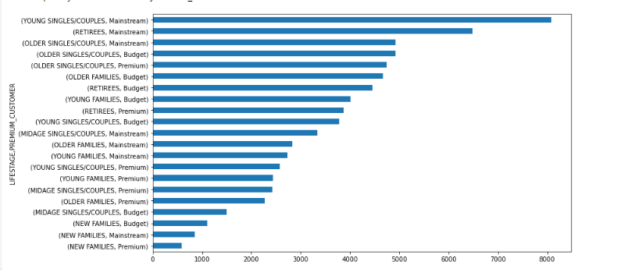
Customer category
Sales increase steadily as the Christmas day approaches and return again
to early December sales level during New Year Eve.
Sales mainly came from Mainstream – young and older singles/couples, and Mainstream - retirees. In total contributing 25% of
sales revenue.

Slide 6
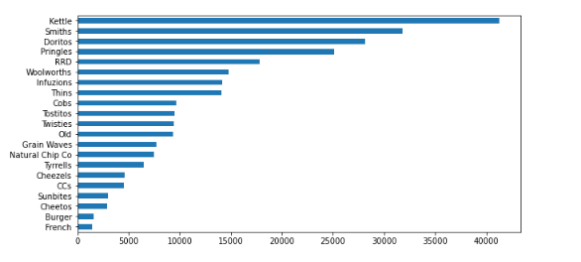
Consumer buying for the category of chips
Chips Brand Kettle is the most purchased brand in all stores.

Slide 7
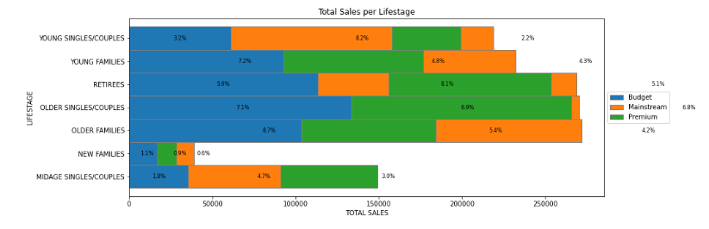
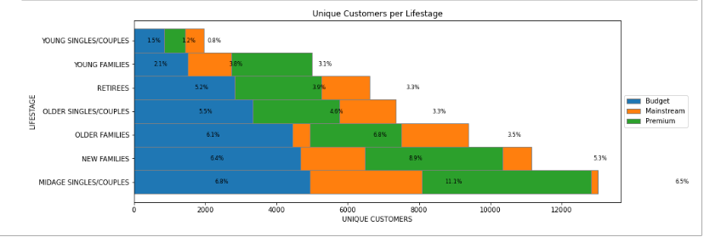
The proportion of customers by affluence and life stage
Sales mainly came from Budget - older families, Mainstream - young
singles/couples, and Mainstream - retirees. In total contributing 25% of
sales revenue.
Older and Young Family segment have the highest average purchase units per unique customer

Slide 8
02
Trial store performance

Slide 9
Control store vs other stores
In the context of this analysis, the terms "control store" and "other stores" are used to classify and compare different types of retail stores, typically in the context of a marketing or business evaluation.
Control stores are used as reference points for comparison, while other stores provide additional context and data for a more comprehensive analysis of how specific changes or strategies affect the performance of retail stores. This approach helps businesses make informed decisions and understand the effectiveness of their actions.

Slide 10
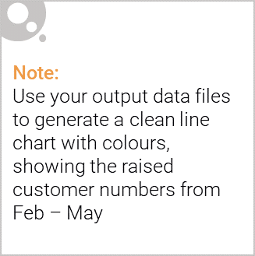
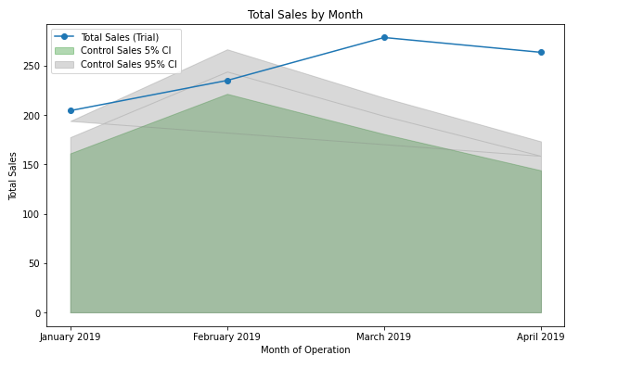
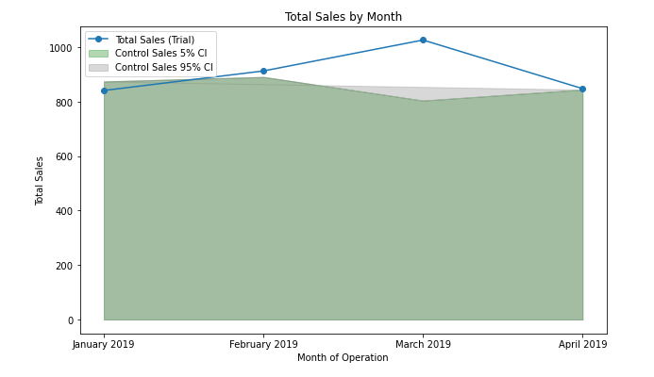
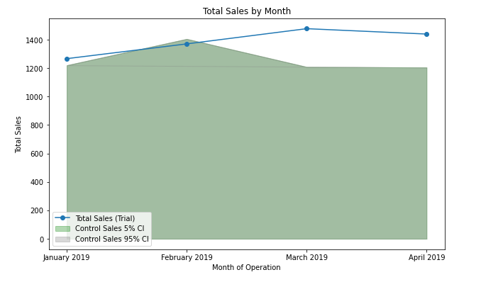
Performance of the trial store
We can see that Trial store 77 sales for Feb, March, and April exceeds 95% threshold of control store. Same goes to store 86 sales for all 3 trial months.
Whereas trial store 88 sales is significantly different to its control store in the trial period as the trial store performance lies outside of the 5% to 95% confidence interval of the control store in two of the three trial months.
Trial Store 77
Trial Store 86
Trial Store 88
Trial Store 77: Control store 233
Trial store 86: Control store 155
Trial store 88: Control store 40
Overall the trial showed positive significant result

